Slide 1

SMART HOME GARDEN
DABDA

Slide 2
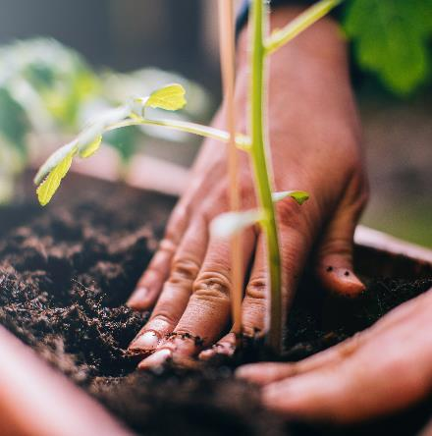
WHAT IS IT ABOUT?
IoT-enabled indoor home garden management solutions monitor and automate processes around small-scale home gardens.
Similar to applications in agriculture and smart farming, smart gardening solutions monitor soil and environmental conditions and check in on the health of plants to improve yield and decrease the amount of human labor required to maintain the garden.

Slide 3

COMPONENTS USED
SOIL MOISTURE SENSOR
WATER LEVEL SENSOR
DHT11

Slide 4
COMPONENTS USED
BMP280
LED
BUZZER

Slide 5

SOIL MOISTURE
Soil moisture is the water content of the soil.
It is a key variable in controlling the exchange of water and heat energy between the land surface and the atmosphere through evaporation and plant transpiration.
As a result, soil moisture plays an important role in the development of weather patterns and the production of precipitation.

Slide 6
WATER LEVEL
Water is essential for photosynthesis.
It is the solvent in which nutrients are carried to, into and throughout the plant. And provides the turgidity by which the plant keeps itself in proper position.
Water level in the container is measured at regular intervals and it sends an alert to the user when the water level is found to be less than the minimum amount required, to water the plant.

Slide 7
HUMIDITY
Humidity is the concentration of water vapour present in the air.
Humidity indicates the likelihood for precipitation, dew, or fog to be present.
Rain forecasting helps the user to save the cost of unnecessary irrigation.

Slide 8
TEMPERATURE
Temperature is a primary factor affecting the rate of plant development.
Greenhouses can be useful for growing plants year-round, especially if one lives in areas with cold seasons. But a greenhouse can only be useful if it is kept at the right temperatures that are beneficial for the plants that are growing inside of it.
So, it is also important to keep a regular check of the temperature of the atmosphere that surrounds the plants.

Slide 9
PRESSURE
Rising or steady pressure indicates clearing and cooler weather.
Slowly falling pressure indicates rain. Rapidly falling pressure indicates a storm is coming.
This helps the user to keep their plants indoors, when a storm is predicted.

Slide 10
SCALABILTY
In the coming years, garden development and maintenance, will rely heavily on automation.
Besides data, IoT-enabled home garden management can, much like its large-scale counterparts, automate irrigation to decrease water waste by using a self-watering pot and, ultimately, save their users’ money and protect their garden from neglect when they travel.
Robotic lawnmowers can be connected to the phone or computer to enable one to easily set a schedule for mowing the lawn and to monitor its progress.

Slide 11
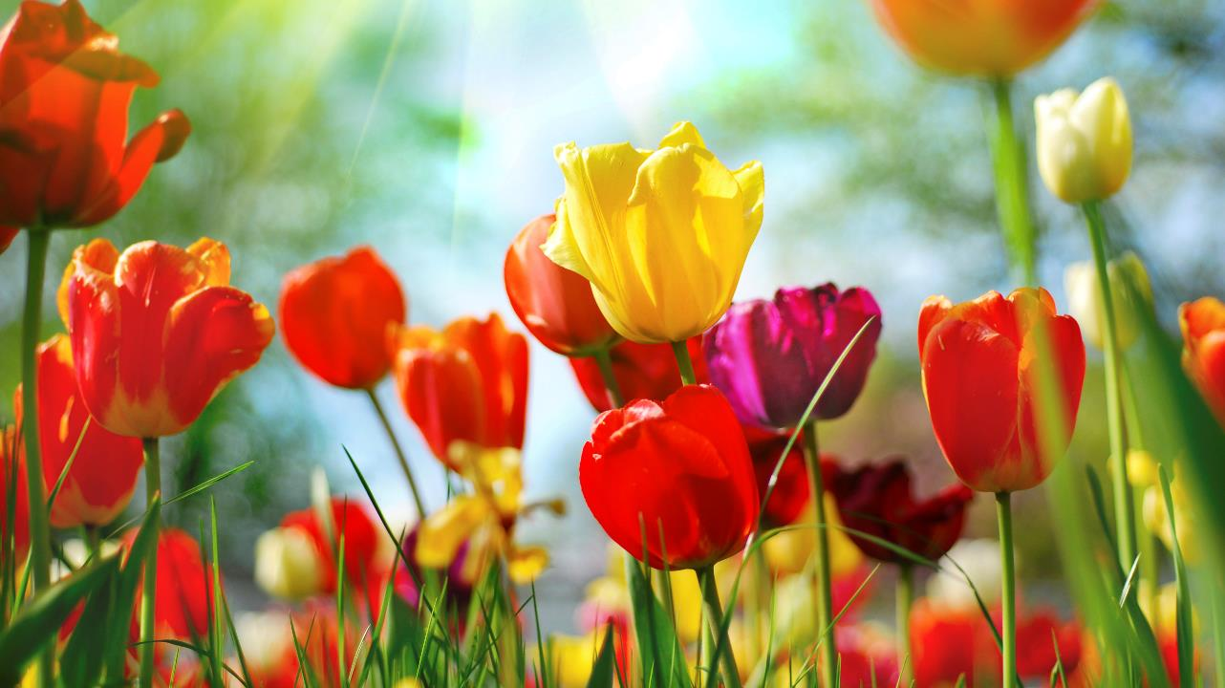
THANK YOU

